Slide 1
ANSIBLE
INTRODUCTION

Slide 2
OUTLINE
Introduction
Ansible Architecture
Technical Details
Demo

Slide 3
What is Ansible?
Ansible - Define and run a single task 'playbook' against a set of hosts(from MAN CMD)
IT Automation , configuration management and provisional tool
It uses playbooks to
deploy, manage, build, test & configure
anything

Slide 4
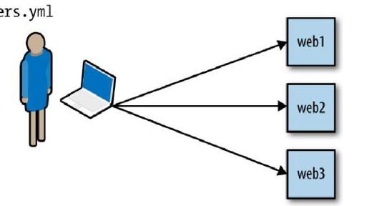
How does it works?

Slide 5
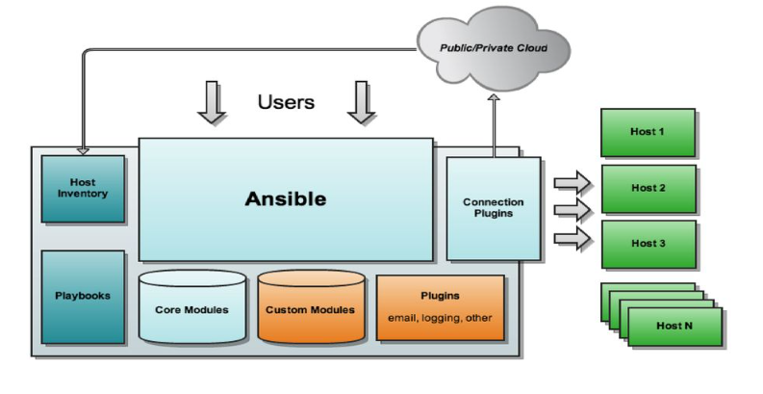
Ansible Architecture

Slide 6
Push Based vs. Pull Based
Tool like Puppet and Chef are pull based
Agents on the server periodically checks for the configuration information from central server (Master)
Ansible is push based
Central server pushes the configuration information on target servers
You control when the changes are made on the servers
Ansible has official support for pull mode, using a tool it ships with called ansible-pull.

Slide 7
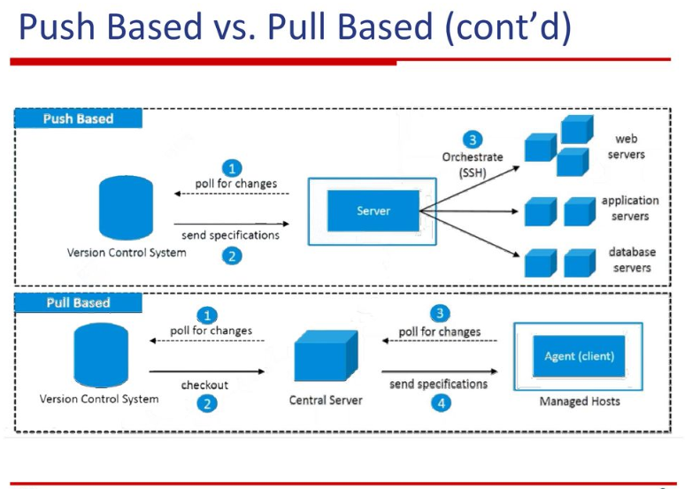
PushBased vs Pull Based

Slide 8
Host Inventory
Ansible can manage only the servers it explicitly knows about.
Information about devices is provided by specifying them in an inventory file.
Each server needs a name that Ansible will use to identify it. You can use the hostname of the server.
Pass additional arguments to tell Ansible how to connect to it.
Default location is /etc/ansible/hosts

Slide 9
Inventory Example [tester]
test1 ansible_host= ansible_port=22 ansible_user=bahador

Slide 10
Ansible Modules
Modules (also referred as task plugins or library plugins) are the ones which actually get executed inside playbook
These are scripts that come packaged with Ansible and preform some kind of action on a host
Example:
apt: Installs or removes packages using the apt package manager
copy: Copies a file from local machine to the hosts
file: Sets the attribute of a file, symlink, or directory
service: Starts, stops, or restarts a service

Slide 11
Configuration fie
/etc/ansible/ansible.cfg -- Config file, used if present
~/.ansible.cfg -- User config file, overrides the default config if present
./ansible.cfg -- Local config file (in current working directory) assumed to be 'project specific' and overrides the rest if present.

